Slide 1
Constrained and Unconstrained Isolation Frameworks in .NET
Pawel Klimczyk
Gemotial

Slide 2

About Pawel
Software engineer
Running Gemotial Software Studio
Member of WrocNET
Contact:
Twitter @pwlklm
Mail: pawel@klimczyk.pl

Slide 3

Software engineer toolbox (I)

Slide 4


Software engineer toolbox (II)
Which one is yours?

Slide 5


Software engineer toolbox (III)
Which one is yours?

Slide 6
Software engineer toolbox (IV)
What contain programmer’s toolbox ?!
Awesome IDE
Build tools
Version control system
Fast workstation
Knowledge about design patterns, angorithms etc.
Design tools
Analysis tools
Debugging tools
Performance tools
Testing tools
Refactoring tools
Knownedge sources (videos, tutorials)
Project management tools

Slide 7
Unit Test
A unit test is an automated piece of code that invokes a unit of work in the system and then checks a single assumption about the behavior of that unit of work.
Roy Osherove

Slide 8
Unit Test Frameworks in .NET
nUnit
xUnit
MbUnit
MSTest
Fixie
Roaster
csUnit

Slide 9
Isolation Frameworks in .NET
Moq
Nsubstitute
FakeItEasy
RhinoMocks
JustMock
Foq
TypeMock
Fakes
EasyMock
NMock3

Slide 10
Constrained & Unconstrained Isolation Frameworks
Constrained (proxy based): Moq, FakeItEast, NSubstitute
Uncontrained (profiler based): Fakes, TypeMock, JustMock

Slide 11
Isolation Frameworks Demo I
Mocking DateTime.Now
Mocking StreamReader

Slide 12
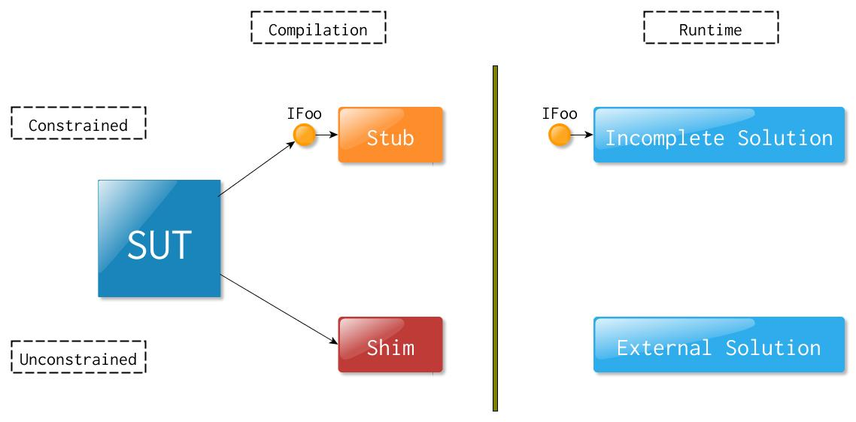
Isolation Frameworks How does it work technically ?! (I)

Slide 13
Unconstrained Isolation Frameworks How does it work technically ?!
COR_ENABLE_PROFILING = 1
COR_PROFILER = {B7ABE522-A68F-44F2-925B-81E7488E9EC}
Prolog & Epilog

Slide 14
Unconstrained Isolation Frameworks Demo II
Mocking static method

Slide 15
Unconstrained Isolation Frameworks Demo III
Mocking sealed class

Slide 16
Unconstrained Isolation Frameworks Demo IV
Mocking private method

Slide 17
Constrained & Unconstrained Isolation Frameworks – Differences (I)
Constrained - replace a class with a small substitute („stub”/”mock”) that implements the same interafe
Uncontrained – modify the compiled code at runtime, to inject and run a substitute („shim”)

Slide 18
Constrained & Unconstrained Isolation Frameworks – Differences (II)
Action | Constrained | Unconstrained
Static Property/Method |  | X
Static Class |  | X
Static Constructor |  | X
Sealed Class |  | X
Virtual Method | X | X
Non-virtual Method |  | X
Private Method |  | X
Private Constructor |  | X

Slide 19
What’s the price and quality?
 | Fakes | TypeMock (Isolator Essential) | JustMock
Price | MS VS 2012 Premium | €399 | $399
Ease of use (1-5) | 2 | 5 | 5
Community (1-5) | 3 | 4 | 4
Support (1-5) | 3 | 5 | 5

Slide 20
Unconstrained Isolation Framework Disadventages
Expensive
Performance overhead
Allows bad design

Slide 21
Summary
Another tool in out toolbox
Useful for legacy code

Slide 22
Image references
https://openclipart.org/detail/2921/toolkit-by-bogdanco
http://en.wikipedia.org/wiki/File:20060513_toolbox.jpg
http://en.wikipedia.org/wiki/File:MaryRose-carpentry_tools1.jpg
http://commons.wikimedia.org/wiki/File:Toolbox_icon_transparent_background.png

Slide 23
Q & A
?

